Slide 1
All Roads lead to philosophy
Austin Barish

Slide 2

Research Topic

Slide 3
Wikipedia overview

Slide 4
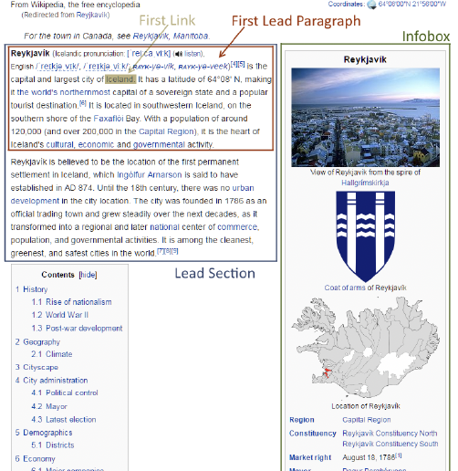
Page Structure
The first link is the first link in the paragraph content itself
Excludes citations and pronunciation
I will be all but entirely focused on the lead paragraph
¹ Evaluating and Improving Navigability of Wikipedia: A Comparative Study of Eight Language Editions, 2016, Daniel Lamprecht, Markus Strohmaier, OpenSym '16: Proceedings of the 12th International Symposium on Open Collaboration

Slide 5
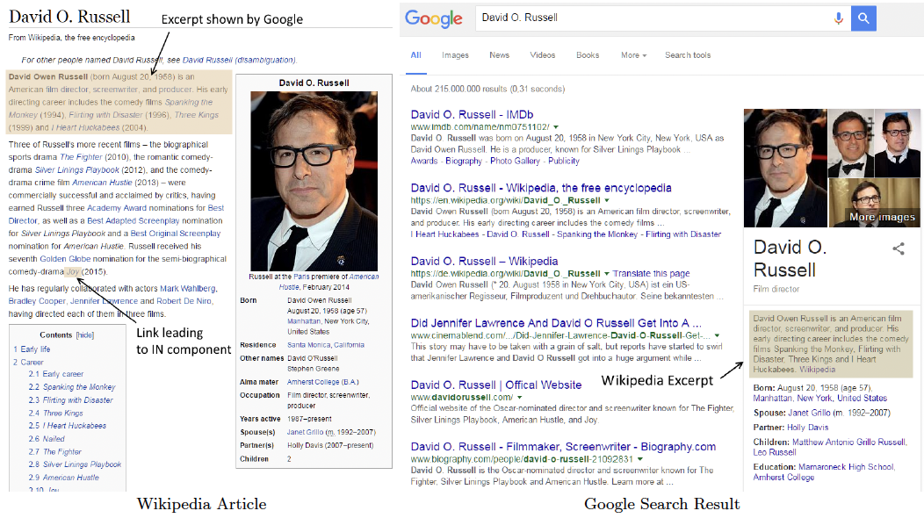
Lead Paragraph
“In Wikipedia, the lead section is an introduction to an article and a summary of its most important contents. It is located at the beginning of the article, before the table of contents and the first heading. It is not a news-style lead or "lede" paragraph.
The average Wikipedia visit is a few minutes long. The lead is the first thing most people will read upon arriving at an article and may be the only portion of the article that they read. It gives the basics in a nutshell and cultivates interest in reading on—though not by teasing the reader or hinting at what follows. It should be written in a clear, accessible style with a neutral point of view.”²
¹ Evaluating and Improving Navigability of Wikipedia: A Comparative Study of Eight Language Editions, 2016, Daniel Lamprecht, Markus Strohmaier, OpenSym '16: Proceedings of the 12th International Symposium on Open Collaboration
² “Wikipedia:Manual of Style/Lead section.” Wikipedia, 2023, https://en.wikipedia.org/wiki/Wikipedia:Manual_of_Style/Lead_section. Accessed 8 July 2023.

Slide 6
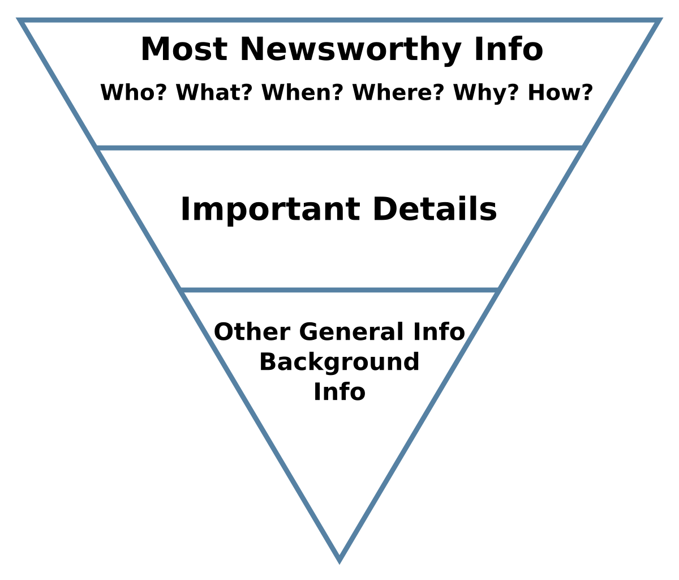
Opening Sentence
“The first sentence should tell the nonspecialist reader what or who the subject is, and often when or where. It should be in plain English.”²
² “Wikipedia:Manual of Style/Lead section.” Wikipedia, 2023, https://en.wikipedia.org/wiki/Wikipedia:Manual_of_Style/Lead_section. Accessed 8 July 2023.
“Inverted pyramid (journalism).” Wikipedia, https://en.wikipedia.org/wiki/Inverted_pyramid_%28journalism%29. Accessed 8 July 2023.

Slide 7
Leading Paragraph Links
Barack Obama
Person
President of the United States
Topic where the person achieved prominence
“The first sentence should provide links to the broader or more elementary topics that are important to the article's topic or place it into the context where it is notable.”²
Social network analysis
Technical or Jargon Term
Networks
Field of Study
Georgetown University
Building or Location
Washington DC
Broader Geographical Area
² “Wikipedia:Manual of Style/Lead section.” Wikipedia, 2023, https://en.wikipedia.org/wiki/Wikipedia:Manual_of_Style/Lead_section. Accessed 8 July 2023.

Slide 8
Getting to Philosophy

Slide 9
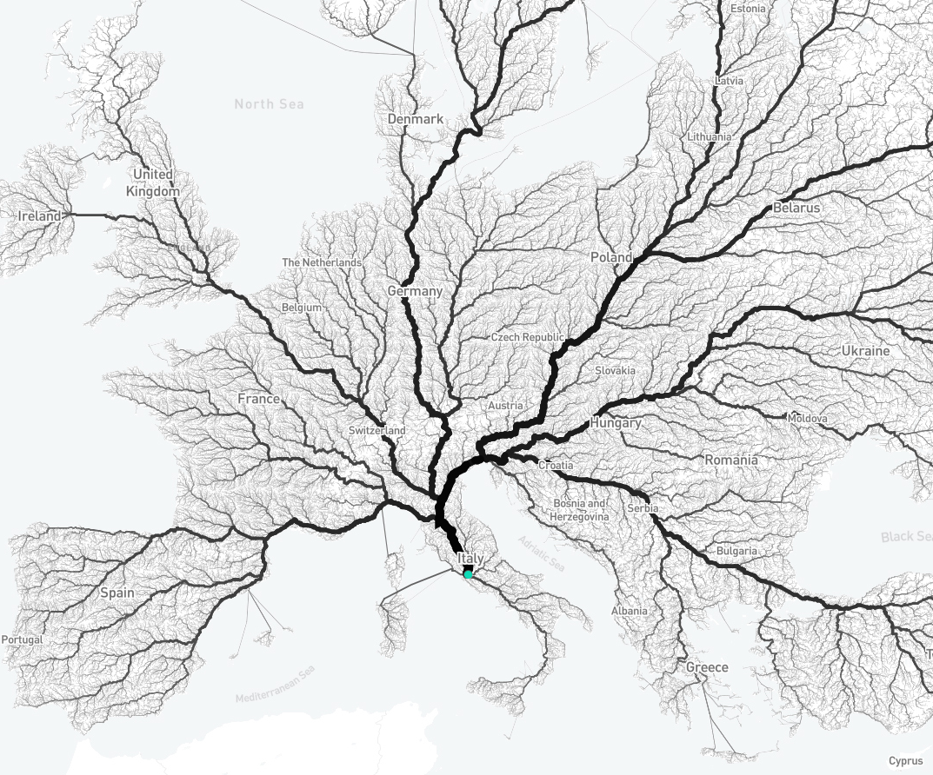
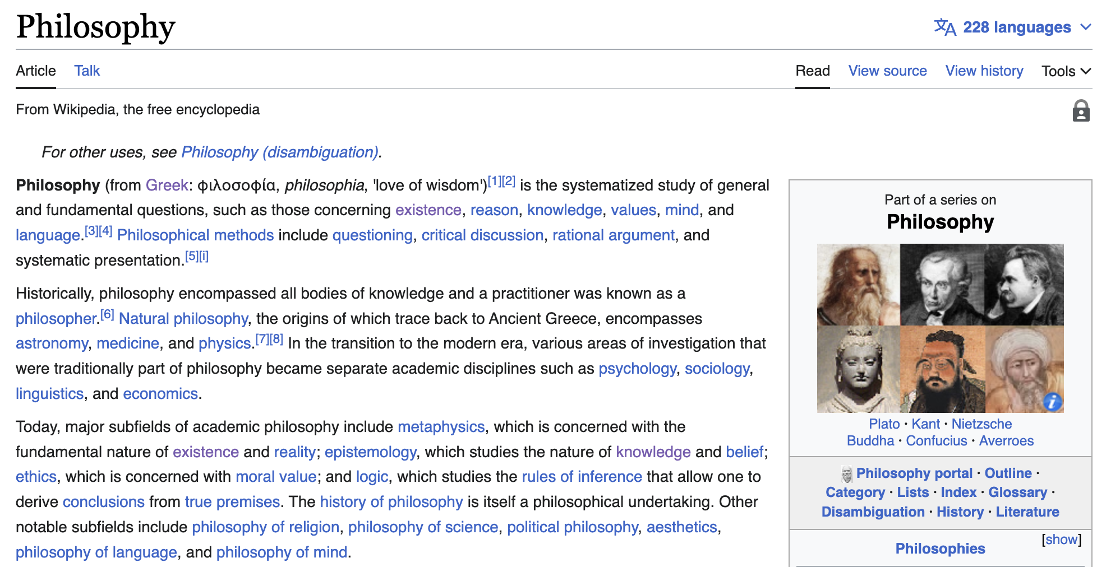
First Link Philosophy
Idea: If you pick any Wikipedia article and click on the first link and repeat the process for every subsequent article, you will eventually reach the philosophy page.
Holds for 97.0% of English Wikipedia articles¹
Results vary by language
First discovered by Wikipedia user Mark J. in May 2008⁴
¹ Evaluating and Improving Navigability of Wikipedia: A Comparative Study of Eight Language Editions, 2016, Daniel Lamprecht, Markus Strohmaier, OpenSym '16: Proceedings of the 12th International Symposium on Open Collaboration
4 “Wikipedia:Getting to Philosophy.” Wikipedia, https://en.wikipedia.org/wiki/Wikipedia:Getting_to_Philosophy. Accessed 8 July 2023.

Slide 10
Example

Slide 11
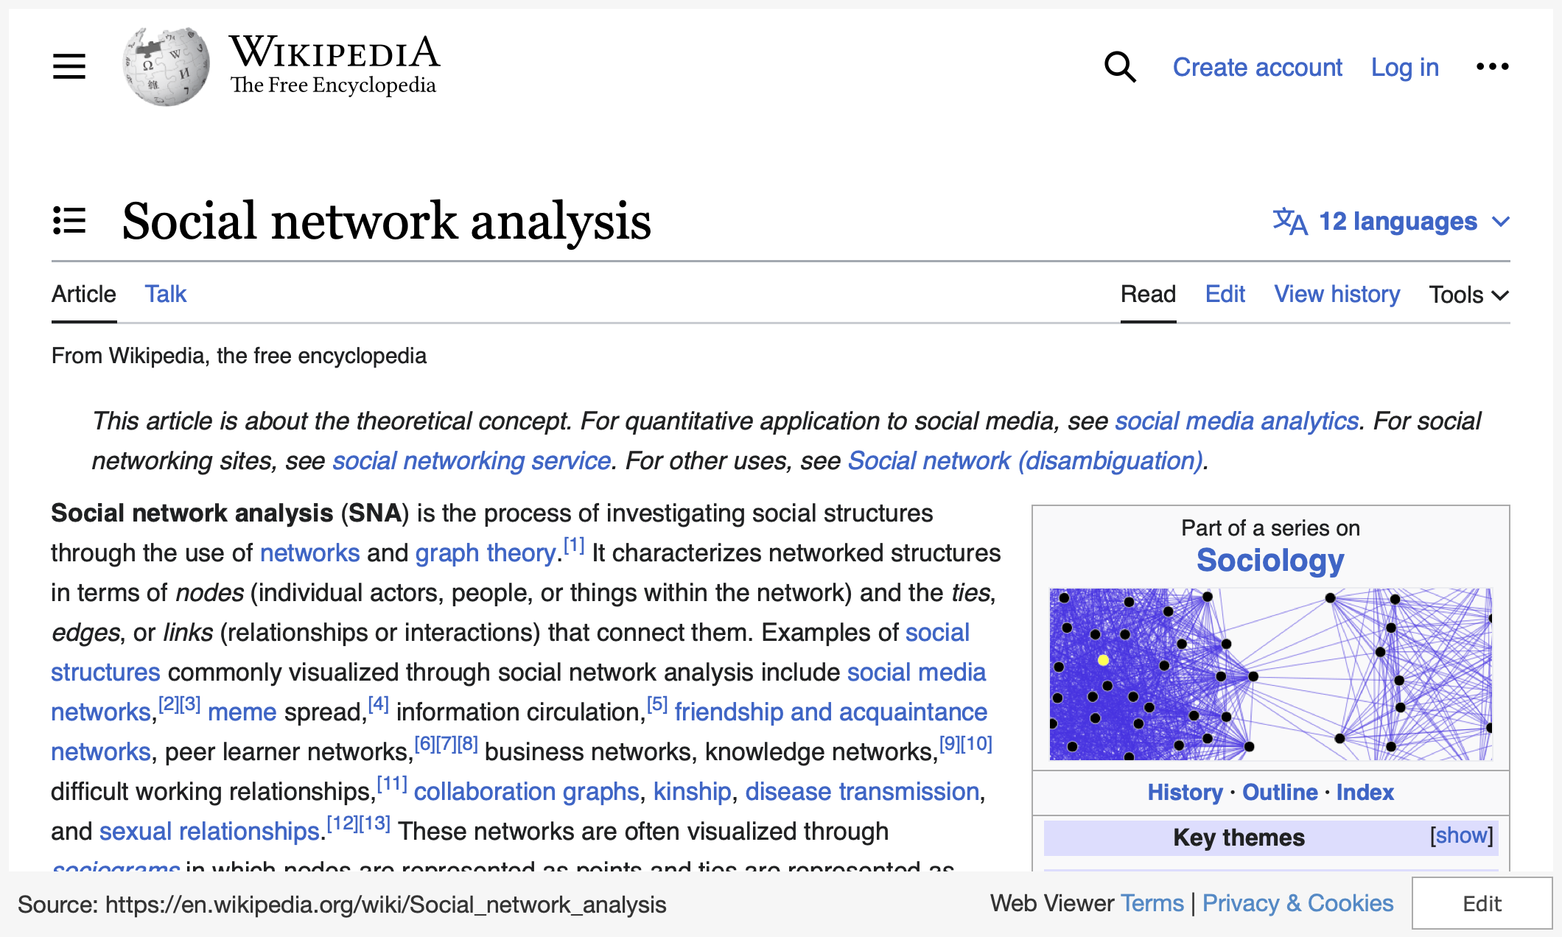

Slide 12
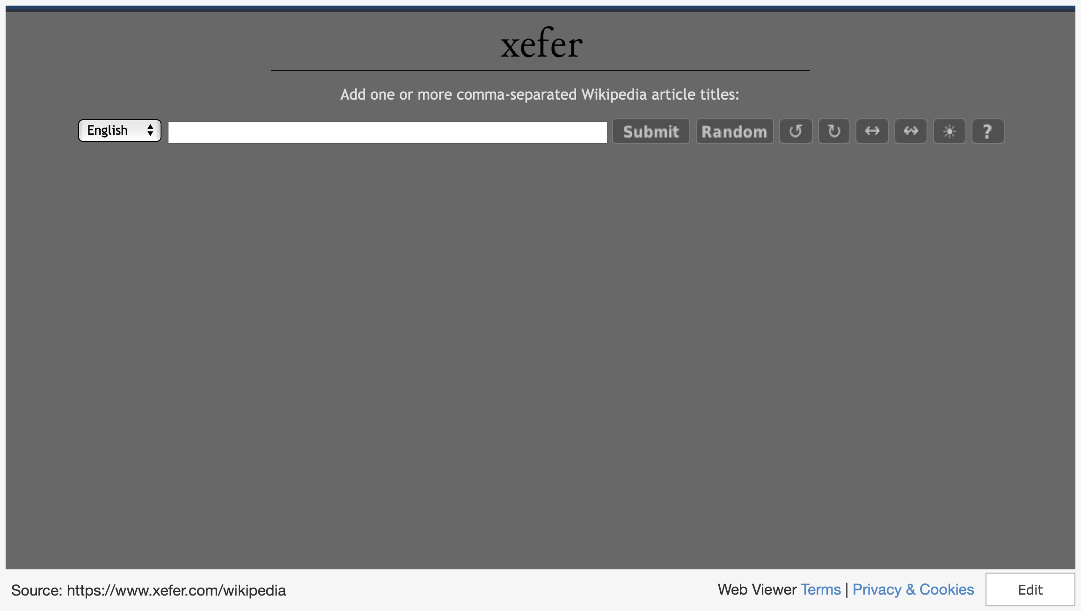
Notes:
Hard coded to get to philosophy meaning even if it naturally wouldn’t by the first link, it will try the next one so it will never fail https://www.xefer.com/wikipedia

Slide 13

Literature REview

Slide 14
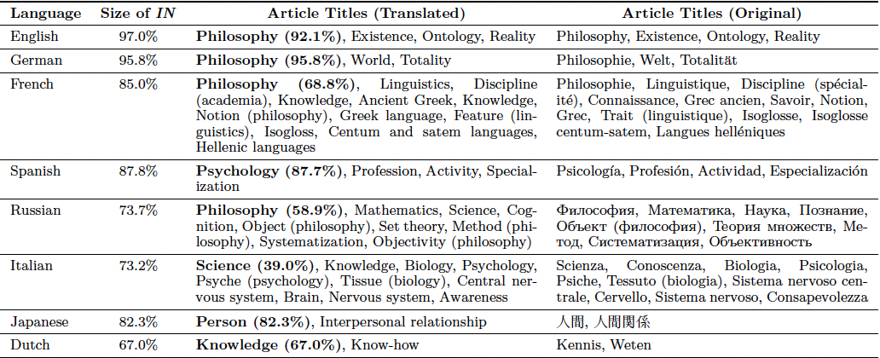
Evaluating and Improving Navigability of Wikipedia: A Comparative Study of Eight Language Editions
Focused on the navigability of Wikipedia by language.
Includes the most recent test of the popular theory of “getting to philosophy”
Illustrates the scale of Wikipedia’s SCC
Demonstrates the importance of links, particularly in the lead for page navigation.
¹ Evaluating and Improving Navigability of Wikipedia: A Comparative Study of Eight Language Editions, 2016, Daniel Lamprecht, Markus Strohmaier, OpenSym '16: Proceedings of the 12th International Symposium on Open Collaboration

Slide 15
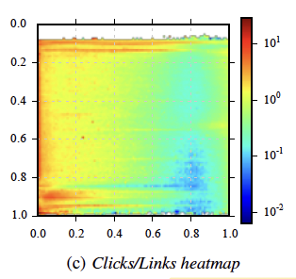
Visual Positions of Links and Clicks on Wikipedia
Studies where users typically click on Wikipedia pages
Found the highest link clicks in the lead and left side
Demonstrates that users use the first few links to navigate Wikipedia
⁵ Visual Positions of Links and Clicks on Wikipedia, 2, 2016, Dimitar Dimitrov, Markus Stromaier, WWW '16 Companion: Proceedings of the 25th International Conference Companion on World Wide Web

Slide 16
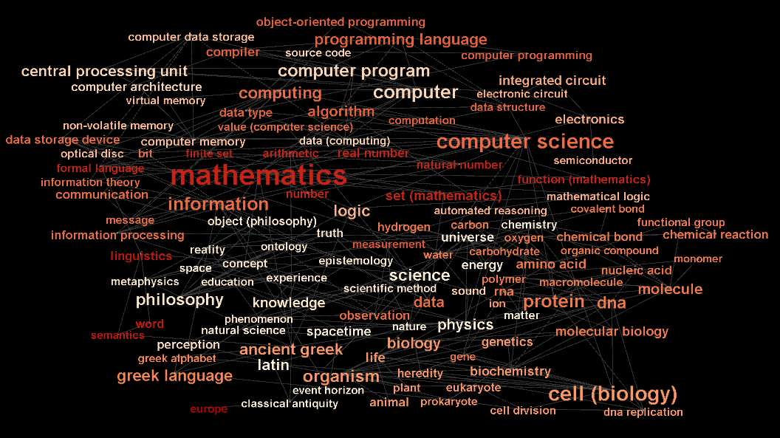
Extracting Domain Knowledge by Complex Networks Analysis of Wikipedia Entries
Examines Wikipedia’s network structure using links as edges and pages as nodes
Only used the first 10 links since they will be the higher density nodes as they are most general topics.
Found entries grouped into communities are more closely semantically related.
Wikipedia can be treated as a small world network.
⁶ Extracting Domain Knowledge by Complex Networks Analysis of Wikipedia Entries, 3, 2015, Neven Matas, Ana Meštrović, 2015 38th International Convention on Information and Communication Technology, Electronics and Microelectronics (MIPRO)

Slide 17

Research Questions and Objectives

Slide 18

What is the current size of the SCC?
Is it still at the 97% found by Lamprecht et al. or has it continued to grow?
Is there a centralized landing point for the 3% of nodes not connected to Philosophy?

Slide 19
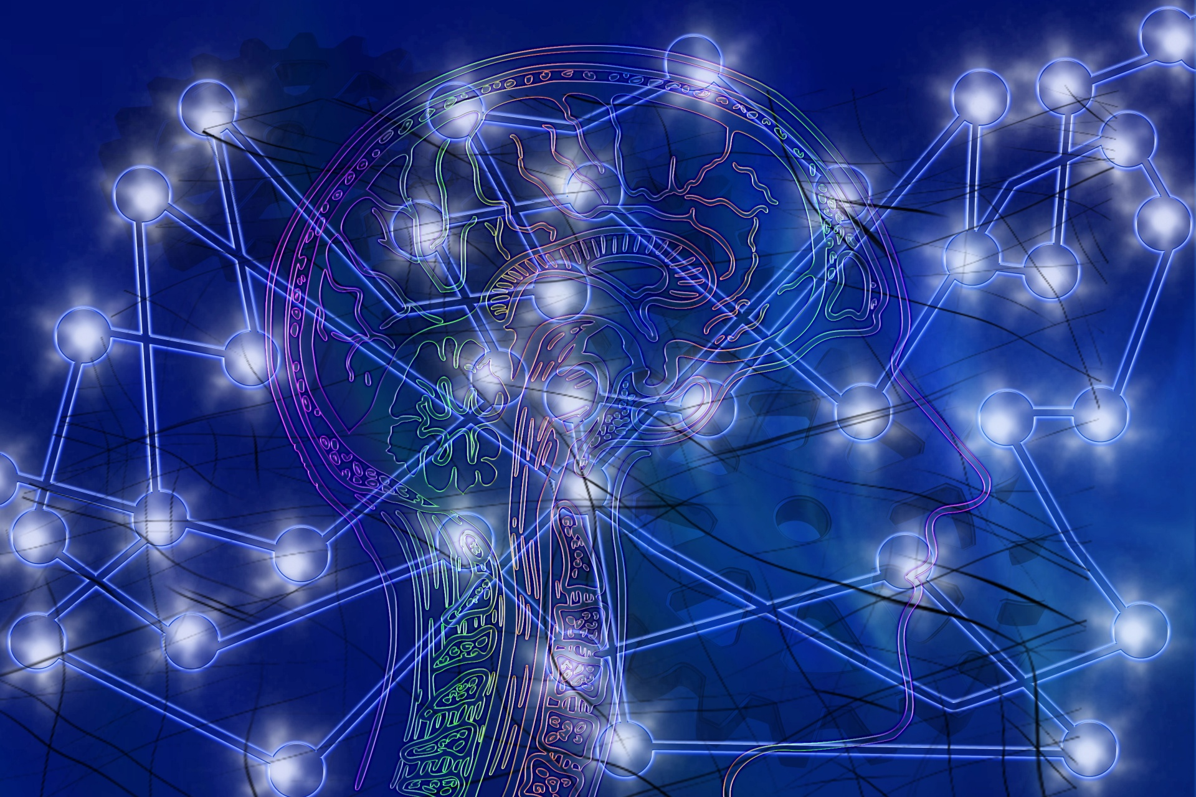
Why is the first link special, if at all?
What does the network of first link edges look like?
If random links are selected, will you reach philosophy at a higher rate than other pages?
Seek to replicate results with other link locations (second, third, etc.)

Slide 20
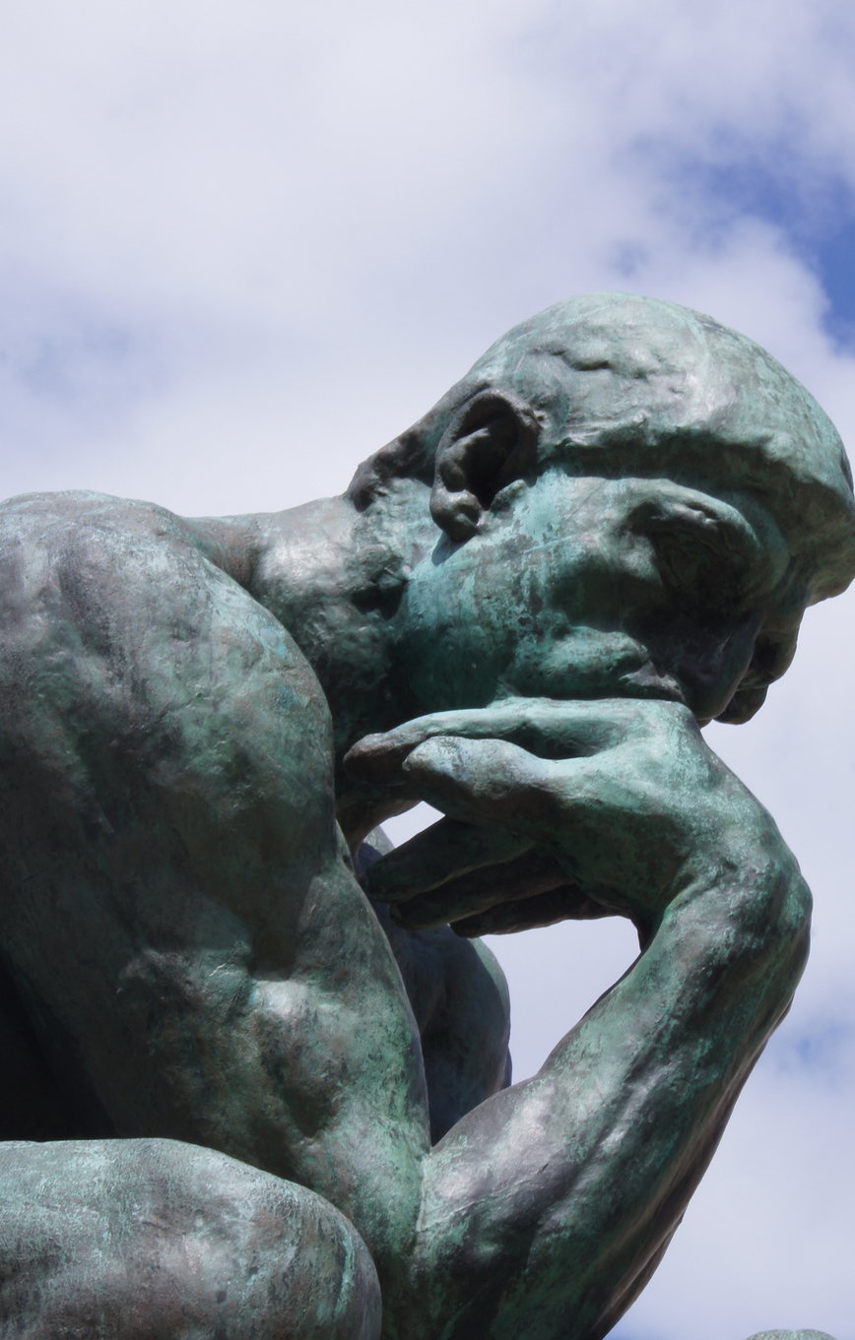
What is the nature of the Philosophy node?
Why is it the center of Wikipedia’s network?
Is it simply because it is a self loop?
Do any other nodes loop back to themselves?
What are its inward facing neighbors?
If you removed philosophy from the network, would it still be strongly connected?
If not, how large would the components be?
What is the average shortest path length to the philosophy node?
What node is furthest from philosophy?
This Photo by Unknown Author is licensed under CC BY

Slide 21

Proposed Methods

Slide 22

Creating the Wikipedia network
I plan to use the Wikipedia API and NetworkX in order to create my network
I would like to find a downloadable network online to save on computing power and time however I am doubtful I will be able to delignate to the first (or other selected) link only
Could prove difficult to examine the full scale of the network
Can instruct to skip over any node that has been seen to reach philosophy since we will know its end-result
This Photo by Unknown Author is licensed under CC BY-SA

Slide 23

Demonstrated Importance
On first impression, it may seem irrelevant that Philosophy is reached by clicking on the first link of a page
Key component of the nature of Wikipedia’s network and navigation
Significant research demonstrating that the lead is all that most people read and that they use its links to learn more1
Making their destinations extra significant
This Photo by Unknown Author is licensed under CC BY

Slide 24
Thank you

